Slide 1
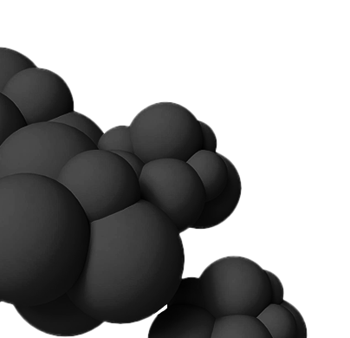
Sky Painting
National Taiwan Normal University CSIE
Advanced Computer Graphics
江家浩 61047061s@gapps.ntnu.edu.tw
張榕宸 61047094s@gapps.ntnu.edu.tw
楊千艎 61047110s@gapps.ntnu.edu.tw

Slide 2
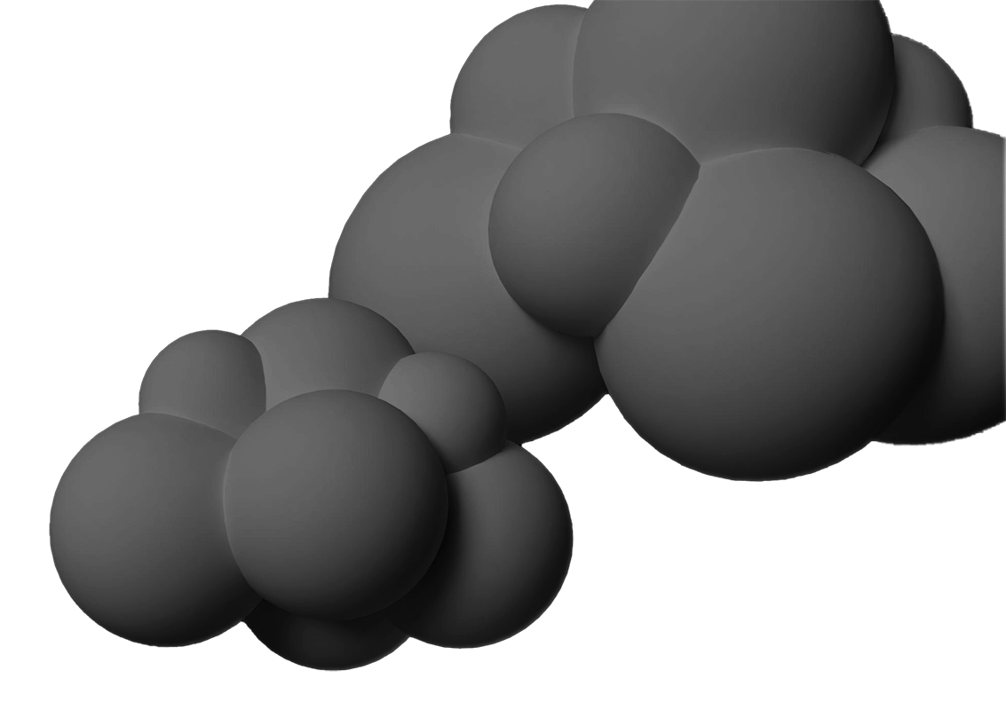
Outline
01.
02.
03.
Introduction
Methodology
Results
04.
05.
06.
Future Work
Reference
Work Division Table

Slide 3
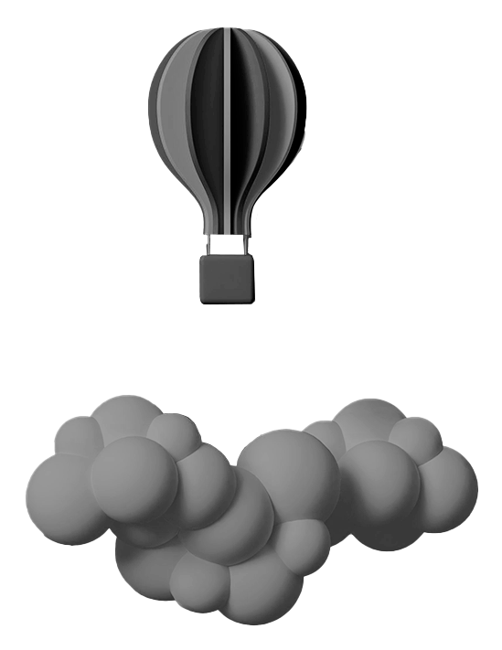
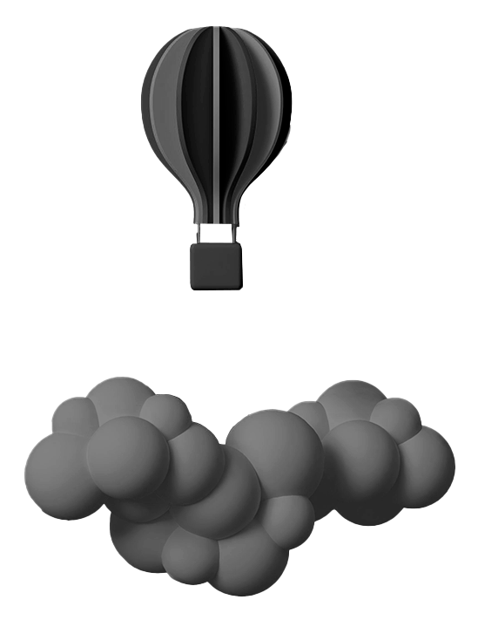
01.
Introduction

Slide 4
Introduction
Why do we pick this topic?
Since the class was focusing on how the lights travel around with a pre-defined objects, I want to do a complete line of scene generation.
What we expect to see?
A sky view containing clouds and some sun-lights

Slide 5

02.
Methodology

Slide 6
02.Methodology
Polynomial surface
Lighting
Shading
Illumination
02.1
02.2
Generator of Polynomial surface (noises generation) for clouds
Determine the relation between surface normal vector and sunlight vector for basic coloring.
02.3
02.4
Handling those pixels in the shadow for not being purely black, but with some gradient. (aliasing)
Interactions among the surface normal vectors.

Slide 7
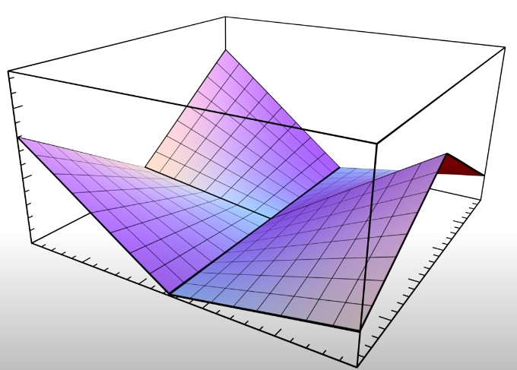
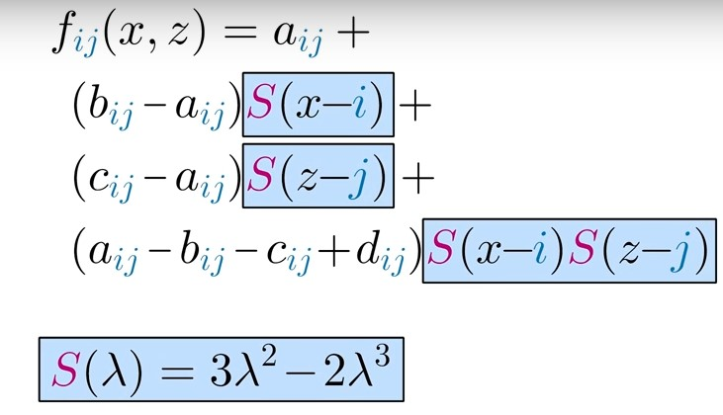
2.1. Polynomial surface
Boundary height (a,b,c,d) are depent with the grid points.
a
b
d
c

Slide 8
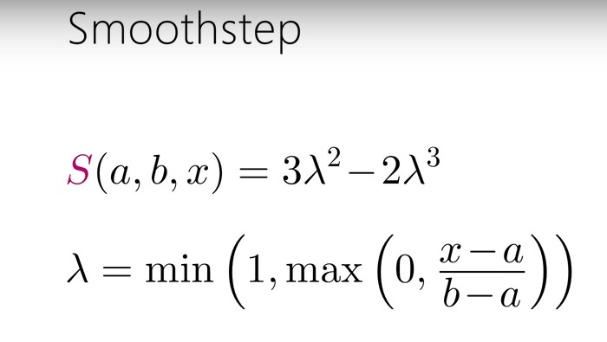
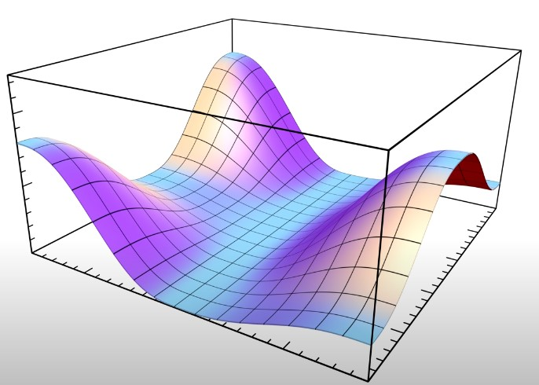
2.1. Polynomial surface
For boundary connection, we adapt the interpolation below.
a
b
d
y
c
a
b
x

Slide 9
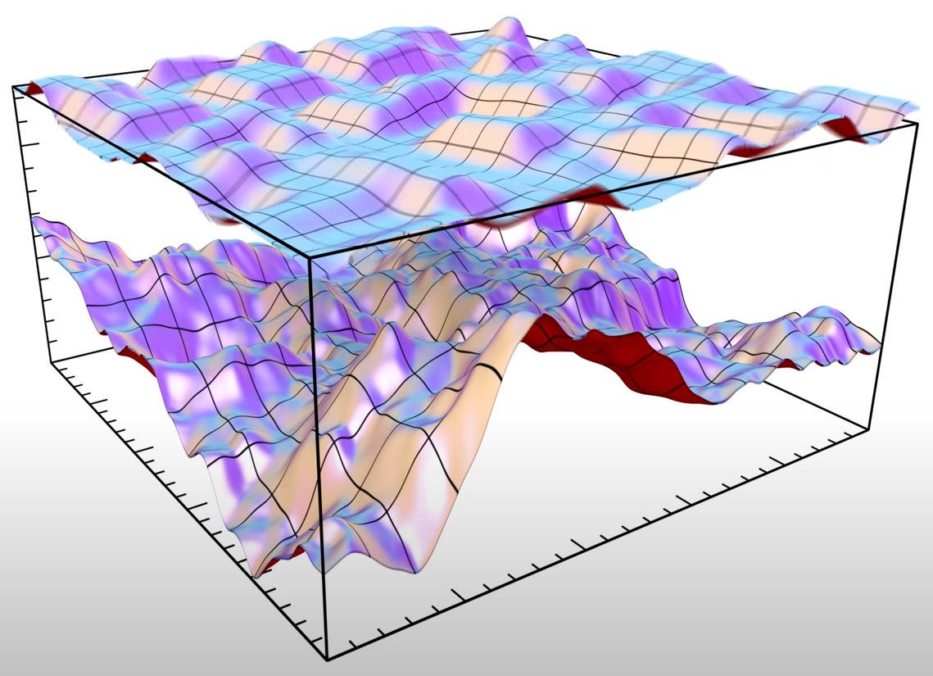
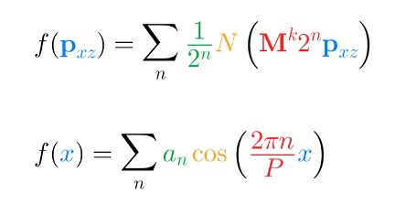
2.1. Polynomial surface
I sum up different frequency planes to approach the fractal clouds, where M is the rotation matrix and N(p) is the plane function.
a
b
d
c
M = | [ 0.64 | 0.36 ]
 | [-0.36 | 0.64 ]

Slide 10
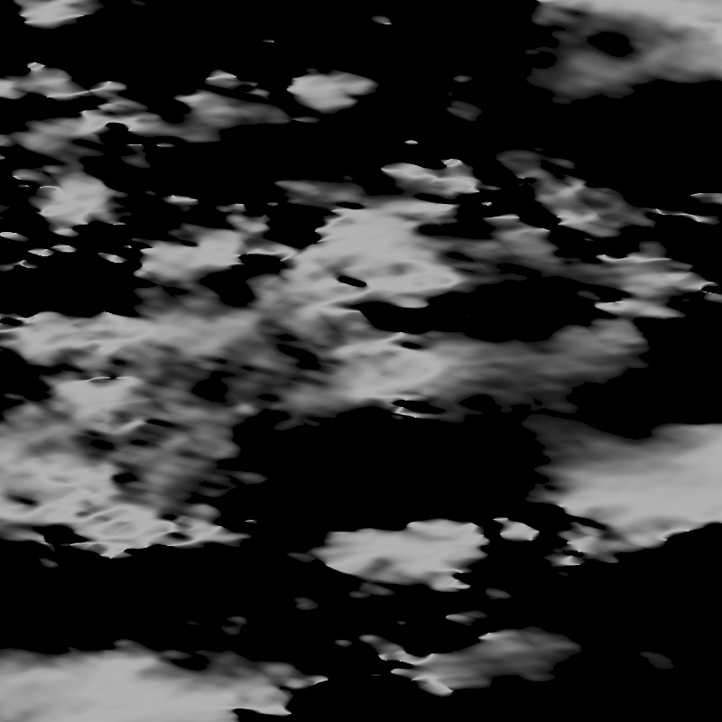
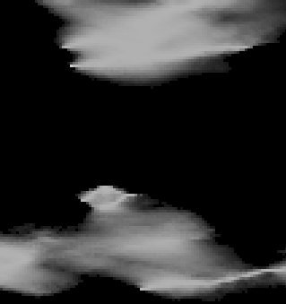
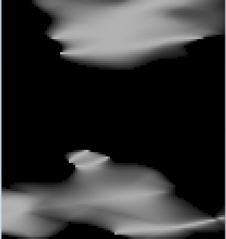
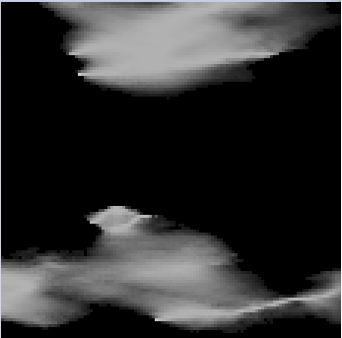


2.1. Polynomial surface
n = 4
n = 8 (picked)
n = 16

Slide 11
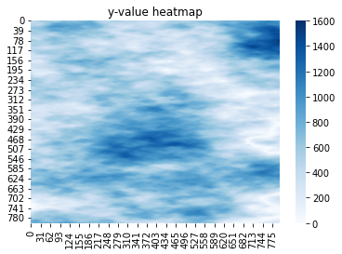
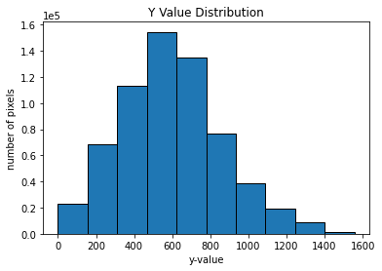
2.1. Polynomial surface
y values heatmap
n = 8, size = 800x800
y values histogram

Slide 12
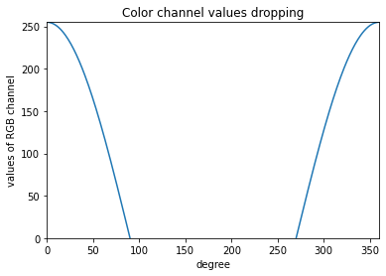
2.2. Lighting
Simply depends on the dot product with normal vector of the cloud surface and the vector pointing the sun (light source)
y
light source (sun)
θ
normal vector
xz plane

Slide 13
2.3. Shading
Within parametric length of the surface normal vector, it searches for the local maximum of the y-value near it, along the sun-light direction, and take the xz-distance and y-value difference as arguments for shadow calculation (exponential decay).
y
light source (sun)
normal vector
y difference
xz distance
xz plane

Slide 14
2.4. Illumination
Originally, I planned to modify a pixel, taking its surrounding normal vectors into consideration. However, the color of clouds should depend on the thickness, or, the traveling distance of the sun-light. Unfortunately, we didn’t make it on time for the algorithm, and therefore I postponed this in future work session.
Alternatively, I simply take the propotion of lighting, coloring contribution of from the surroundings; therefore, it’s not appropriate to use “illumination” in this extent, but I think sometimes the simpler, the better.

Slide 15
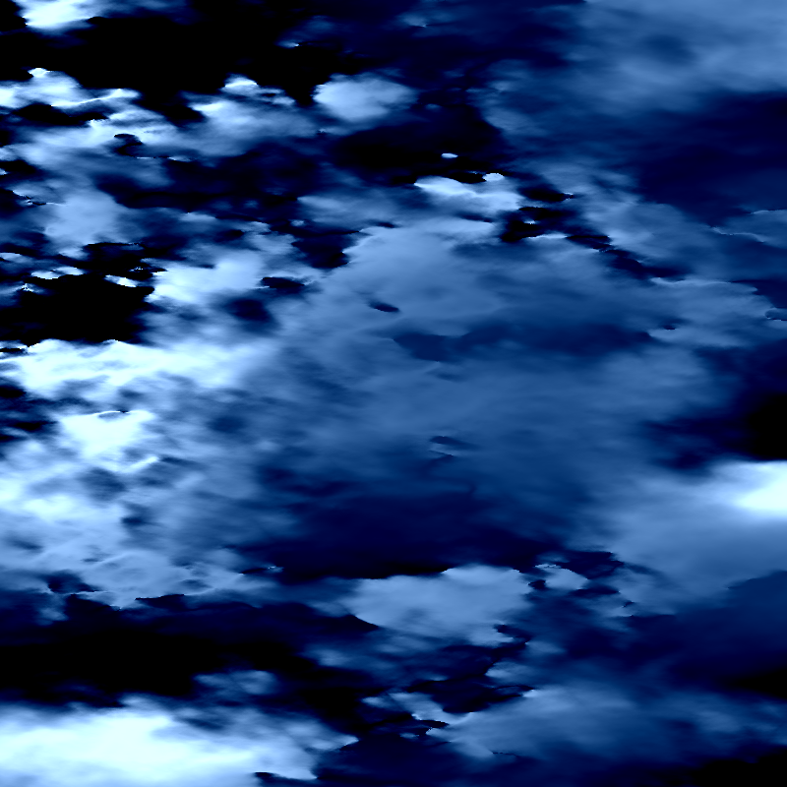
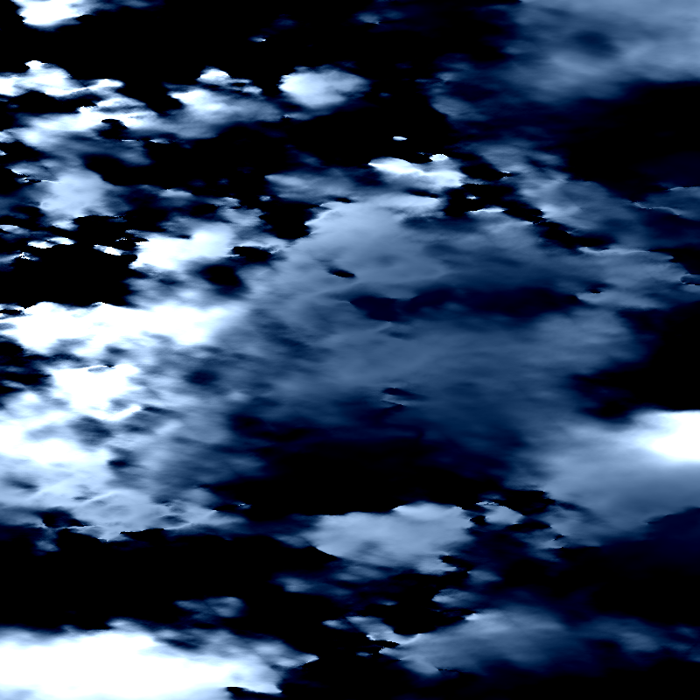
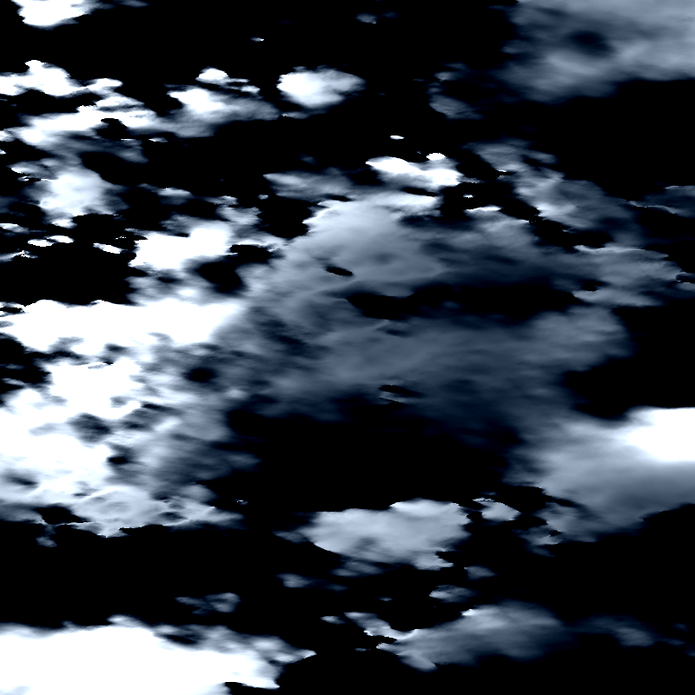
04. Illumination
Wc, Ws: coefficients of cloud color and sky color
(Wc, Ws) = (0.4, 0.6)
(picked)
(Wc, Ws) = (0.6, 0.4)
(Wc, Ws) = (0.8, 0.2)

Slide 16
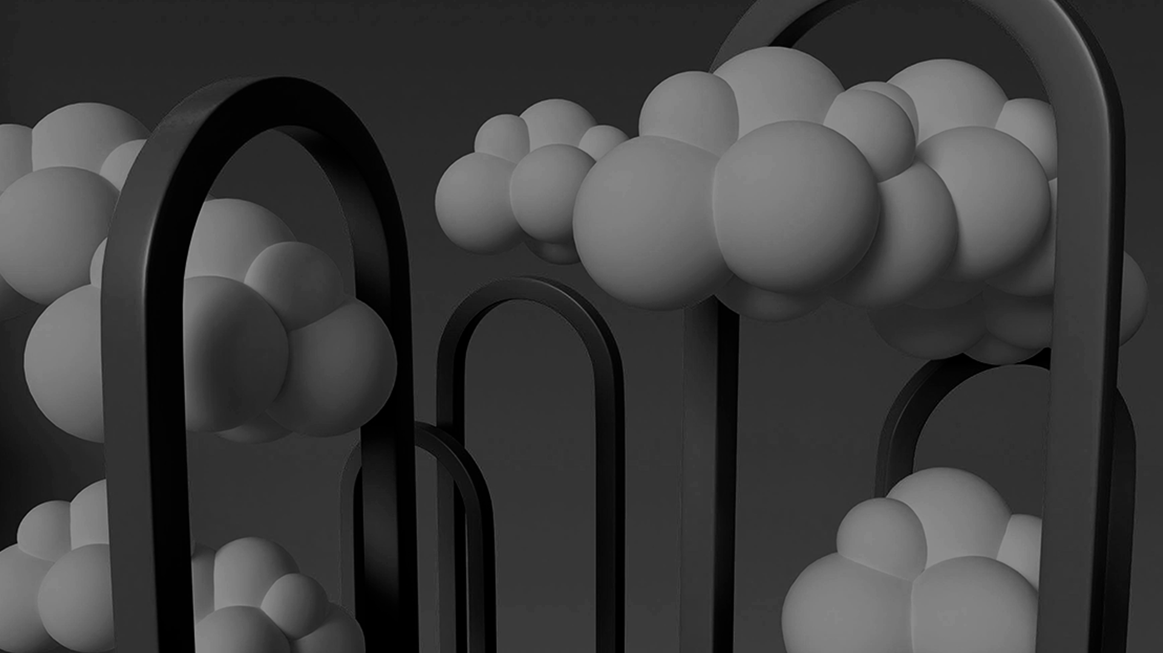
03.
Results

Slide 17
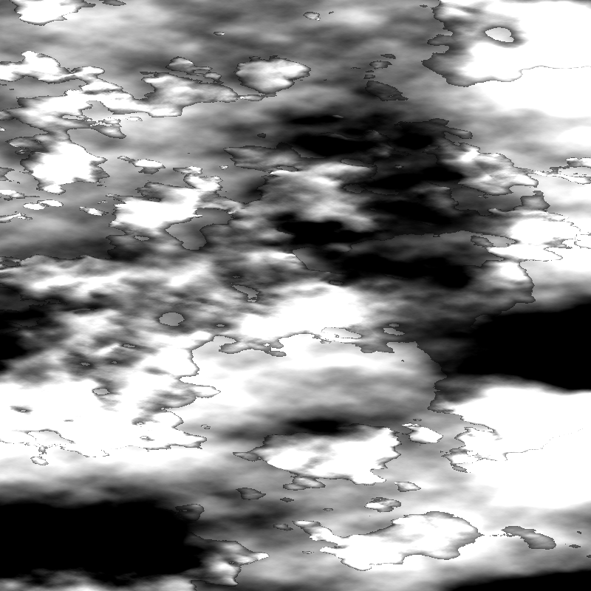
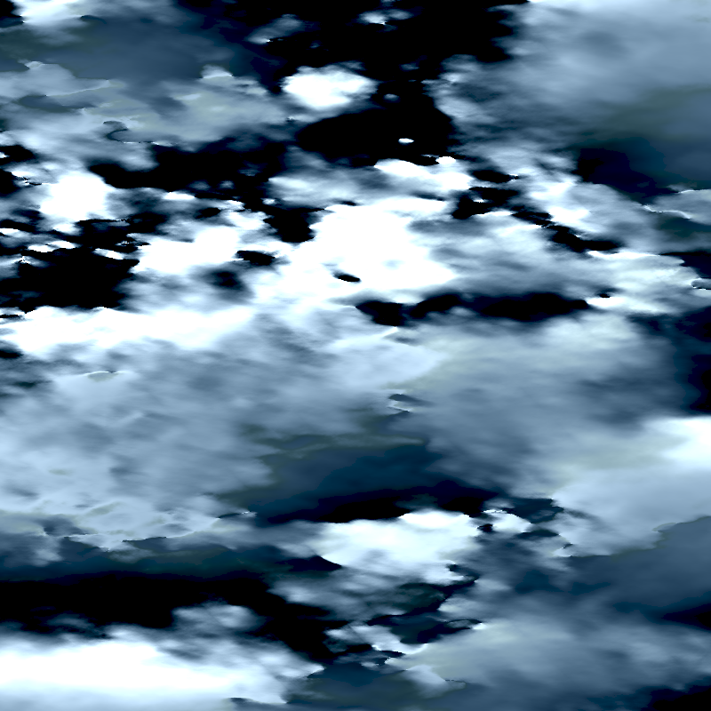
03. Results
Finally, add sun-light reflection from cloud surface to eyes with the coefficient, Wr = 0.05.
threshold = 600
Final Painting

Slide 18

04.
Future Work

Slide 19
04. Future Work
Cloud thickness algorithm for telling cloud heights and make them more fluffy
Sun glare effect
Add other objects in the sky
Vanishing point coordinate system

Slide 20
05.
Reference

Slide 21
05. Reference
[1] Painting a Landscape with Maths by InigoQuilez
https://www.youtube.com/watch?v=BFld4EBO2RE&ab_channel=InigoQuilez
[2] Ray Tracing in One Weekend by Peter Shirley https://raytracing.github.io/books/RayTracingInOneWeekend.html

Slide 22
06.
Work Division Table

Slide 23
06. Work Divsion Table
Team Member | Student ID | Contribution
江家浩 | 61047061s | Slides, and Others
張榕宸 | 61047094s | Slides and parameter testing
楊千艎 | 61047110s | Slides and parameter testing

Slide 24

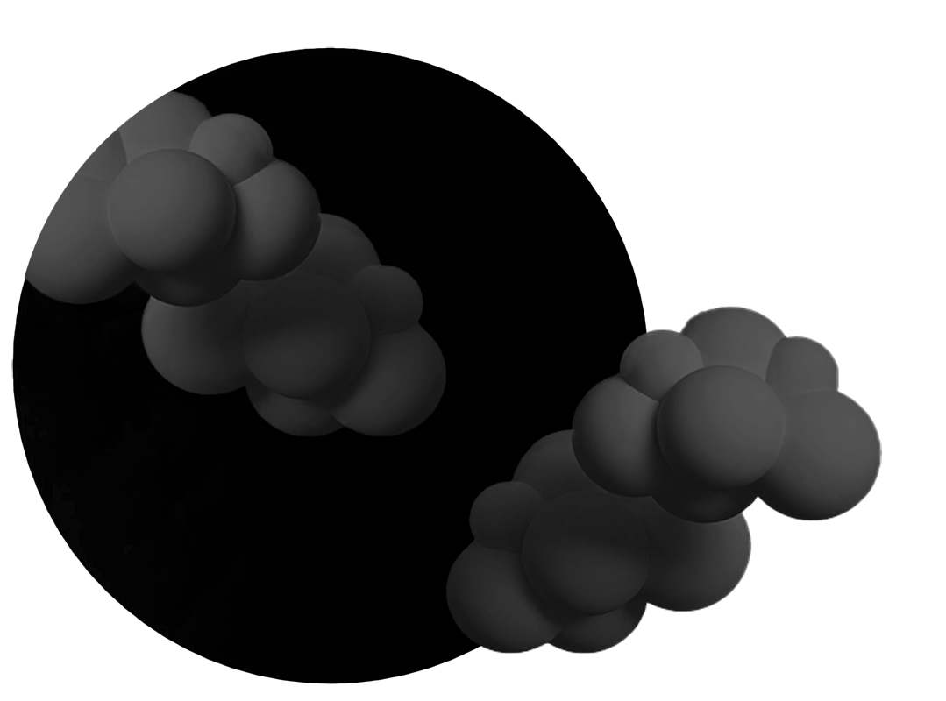
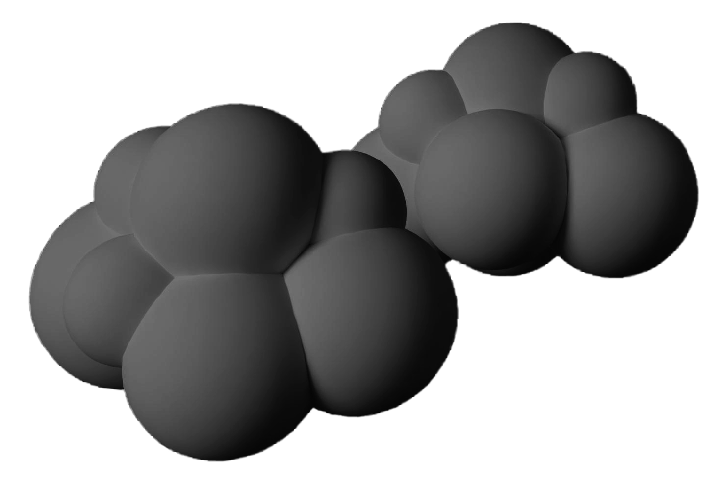
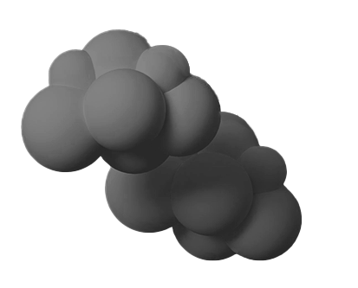
Thank you for listening!

